Slide 1
A Performance Benchmark for Antidote
Guided By : Deepthi Akkoorath
Presented by : Alka Scaria, Vishnu Vardhan Sundarrajan, Tchangou Maxime, Kevin Bartik

Slide 2
STEPS

Slide 3
Step 1 –
https://syncfree.github.io/antidote/
https://github.com/basho/basho_bench
https://www.docker.com/
https://github.com/SyncFree/antidote
https://github.com/brianfrankcooper/YCSB
http://jmeter.apache.org/
https://github.com/SyncFree/antidote-java-client

Slide 4
Step 2 – Identifying Major Components
Output (Graph)
Antidote
Input
Benchmarking Tool
Input
Visualization
Docker

Slide 5
Step 3 – Decision Making
Programing Language
Java
Erlang
Operating System
Windows
Linux
IDE
Benchmarking Tool
IntelliJ
Eclipse
Basho Bench
YCSB
JMeter

Slide 6
Step 4 - Architecture
Antidote Container
Antidote Client
Antidote Client Wrapper
YCSB
YCSB Client
Visualization of the Result
Docker
Docker Manager

Slide 7
Outline
Docker Connection to Antidote Client
Antidote Client Wrapper
Benchmarking using YCSB
Visualization of Results

Slide 8
Docker Connection to Antidote Client (1/5)

Slide 9
Docker Connection to Antidote Client (2/5)

Slide 10
Docker Connection to Antidote Client (3/5)

Slide 11
Docker Connection to Antidote Client (4/5)

Slide 12
Docker Connection to Antidote Client (5/5)

Slide 13
Antidote Client Wrapper
Interface between Antidote Database and any Benchmarking Tool
Read and Write Operations
Operations
Single Read
Single Write
List of Read
List of Write
Combination of Read and Write
Read – Read List
Write – Update List

Slide 14
Benchmarking using YCSB (1/2)
What is YCSB?
YCSB – Yahoo! Cloud Serving Benchmark
YCSB is a framework for bench-marking systems. The primary goal of YCSB is to develop framework and common set of workloads to evaluate the different ‘Key – value’ and ‘Could’ serving stores.
YCSB mainly benchmarks the throughput and latency of the database operation.
We have to create the DB interface layer to add any new database. This interface layer will have few operations(Insert, delete, update,scan) available in YCSB.

Slide 15
Benchmarking using YCSB (2/2)
YCSB helps to benchmark the database using workloads. There are six different core workload available in YCSB. Also we can create customized workload to run benchmark. Below are the few workload properties:
readproportion, updateproportion,maxscanlength,exportfile,etc.,

Slide 16
Visualization of Results

Slide 17
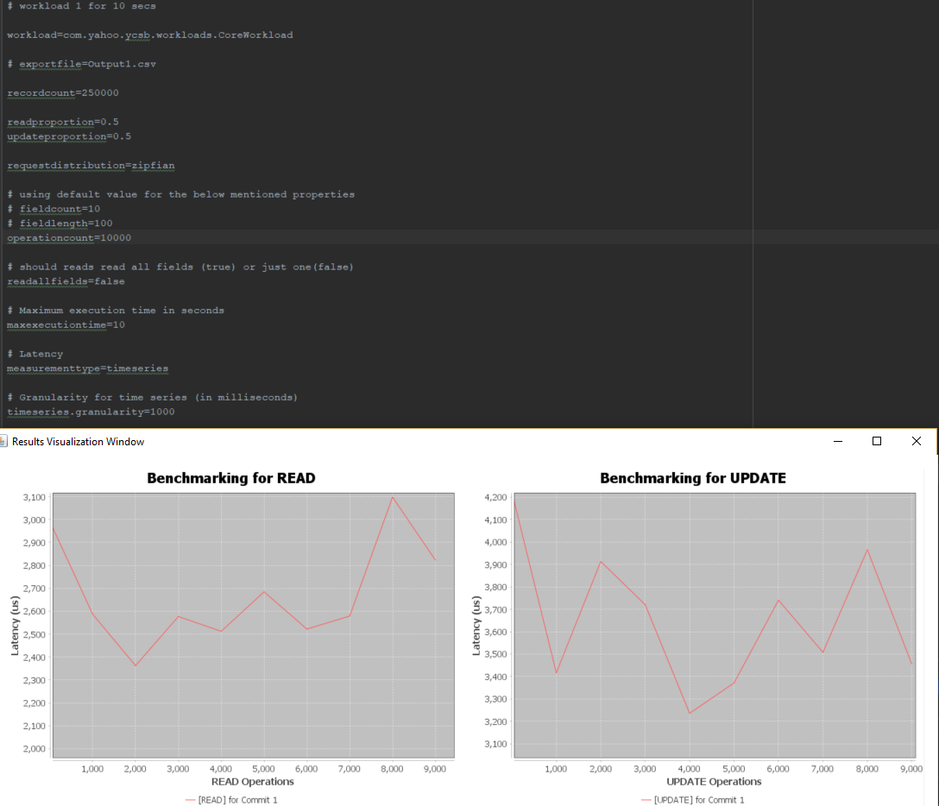
Sample Result

